Slide 1
Customer Study and Value Proposition

Slide 2
Identifying your customer segments and early adopters is a crucial step in developing a successful business or launching a new product or service.
1. Define Your Target Market:
Start by defining the characteristics of the market you intend to serve. Consider demographics (age, gender, income), psychographics (lifestyle, values, interests), and geographic location.
2. Conduct Market Research:
Use surveys, interviews, and secondary research to gather data about potential customers. This can include information about their needs, pain points, and preferences.
3. Segment Your Market:
Divide your target market into distinct segments based on common characteristics and needs. Segmentation can be done using criteria like demographics, behaviour, and psychographics. For example, you might have segments like "young professionals," "stay-at-home parents," or "small business owners."

Slide 3
4. Create Customer Personas:
Develop detailed customer personas for each segment. These are fictional representations of your ideal customers within each segment, including their names, ages, job titles, goals, and challenges.
5. Identify Early Adopters:
Early adopters are the customers most likely to embrace your product or service first. Look for characteristics like:
Innovative mindset: Early adopters are open to trying new things and embracing innovation.
Problem solvers: They actively seek solutions to their problems or pain points.
Readiness to take risks: Early adopters are willing to take a chance on new products or services.
Strong influence: They often have a network of followers or peers who trust their recommendations.
6. Validate Your Assumptions:
Test your customer segments and early adopter assumptions through market research, surveys, or pilot programs. Collect feedback and adjust your strategies based on the results.

Slide 4
7. Refine Your Marketing Strategy:
Tailor your marketing efforts to target each customer segment effectively. Craft messaging, channels, and offers that resonate with their specific needs and preferences.
8. Launch and Monitor:
Launch your product or service with a focused approach targeting early adopters and the identified customer segments. Continuously monitor and gather data on customer behaviour and feedback.
9. Expand to Other Segments:
Once you've gained traction with early adopters, gradually expand your marketing efforts to reach broader customer segments. Use the insights gained from early adopters to refine your offering.
10. Iterate and Evolve: - Be prepared to iterate and adapt your strategies as you gather more data and insights. Customer preferences and market dynamics can change over time.
Notes:
Remember that identifying customer segments and early adopters is an ongoing process. As your business evolves and grows, your understanding of your customers may also change, and you may need to refine your segmentation and targeting strategies accordingly.

Slide 5
Customer Segmentation Models: Types, Benefits & Uses
What is a Customer Segmentation Model?
A customer segmentation model is a way of dividing a wide group of people into smaller groups based on their commonalities. How you divide your larger customer base into those smaller subgroups will vary based on what your brand does and who your customers generally are.
For a business-to-consumer brand, your customer segmentation models may focus on shared demographics like age, gender, and income level.

Slide 6
Further benefits of finding the right customer segmentation model include:
Increase consumer engagement: Targeted ads and marketing messages connect the right-fit potential consumers to your brand and encourage continued engagement from existing consumers.
Increase consumer satisfaction and loyalty: The customer that feels seen, heard, and understood by a brand is going to be far more satisfied, and loyal, than the one who feels like they’re just an order number.
Improve ROI: Customer segmentation eliminates wasted time, and therefore money, on marketing efforts that don’t target the right audience. When you understand your consumers and what they need, you can help them fill that need faster and more efficiently.

Slide 7
The customer adoption patterns for a new product or service
Customer adoption patterns refer to the stages through which customers embrace and integrate a new product or service into their lives or businesses. Understanding these patterns is crucial for businesses to effectively market and launch their offerings. The adoption process typically involves different categories of customers, and one key group is the early adopters.
Customer Adoption Patterns:
Innovators:
Characteristics: Risk-takers and technology enthusiasts.
Percentage of Population: Small percentage (around 2.5%).
Role: Embrace new products or services at the earliest stage.
Early Adopters:
Characteristics: Visionaries, opinion leaders, and influencers.
Percentage of Population: Around 13.5%.
Role: Adopt innovations early and help create buzz and momentum.
Early Majority:
Characteristics: Pragmatic and deliberate decision-makers.
Percentage of Population: Around 34%.
Role: Adopt after the early adopters, validating the product's usefulness.

Slide 8
The customer adoption patterns for a new product or service
Late Majority:
Characteristics: Skeptical and risk-averse.
Percentage of Population: Another 34%.
Role: Adopt once the majority has already embraced the product.
Laggards:
Characteristics: Traditionalists and resistant to change.
Percentage of Population: The final 16%.
Role: Adopt very late, often when the product has become a standard.
Importance of Early Adopters:
Early Validation:
Early adopters provide initial validation for the product's viability and appeal.
Word-of-Mouth Marketing:
Influential early adopters can generate positive word-of-mouth, attracting more customers.
Feedback and Improvement:
Early adopters offer valuable feedback, helping the company improve the product or service.

Slide 9
The customer adoption patterns for a new product or service
Building Momentum:
Early adopters create momentum and enthusiasm, attracting the attention of the early majority.
Market Positioning:
Success with early adopters helps position the product positively in the market.
Reference Customers:
Early adopters can become reference customers, providing testimonials and case studies.
Credibility and Trust:
Being embraced by thought leaders and influencers builds credibility and trust in the product.
Reducing Market Risks:
The acceptance of early adopters reduces perceived risks for the early majority.
Strategies to Appeal to Early Adopters:
Targeted Marketing:
Craft marketing messages that resonate with the visionary and innovative mindset.

Slide 10
The customer adoption patterns for a new product or service
Exclusive Access:
Offer early access or exclusive features to incentivize early adoption.
Engagement and Communication:
Engage with early adopters, listen to their feedback, and communicate openly.
Building a Community:
Foster a community around the product to encourage collaboration and advocacy.
Iterative Development:
Demonstrate a commitment to continuous improvement based on early adopter feedback.
In summary, understanding customer adoption patterns and recognizing the significance of early adopters is essential for a successful product or service launch. Early adopters play a pivotal role in shaping the product's trajectory and influencing its broader acceptance in the market.

Slide 11
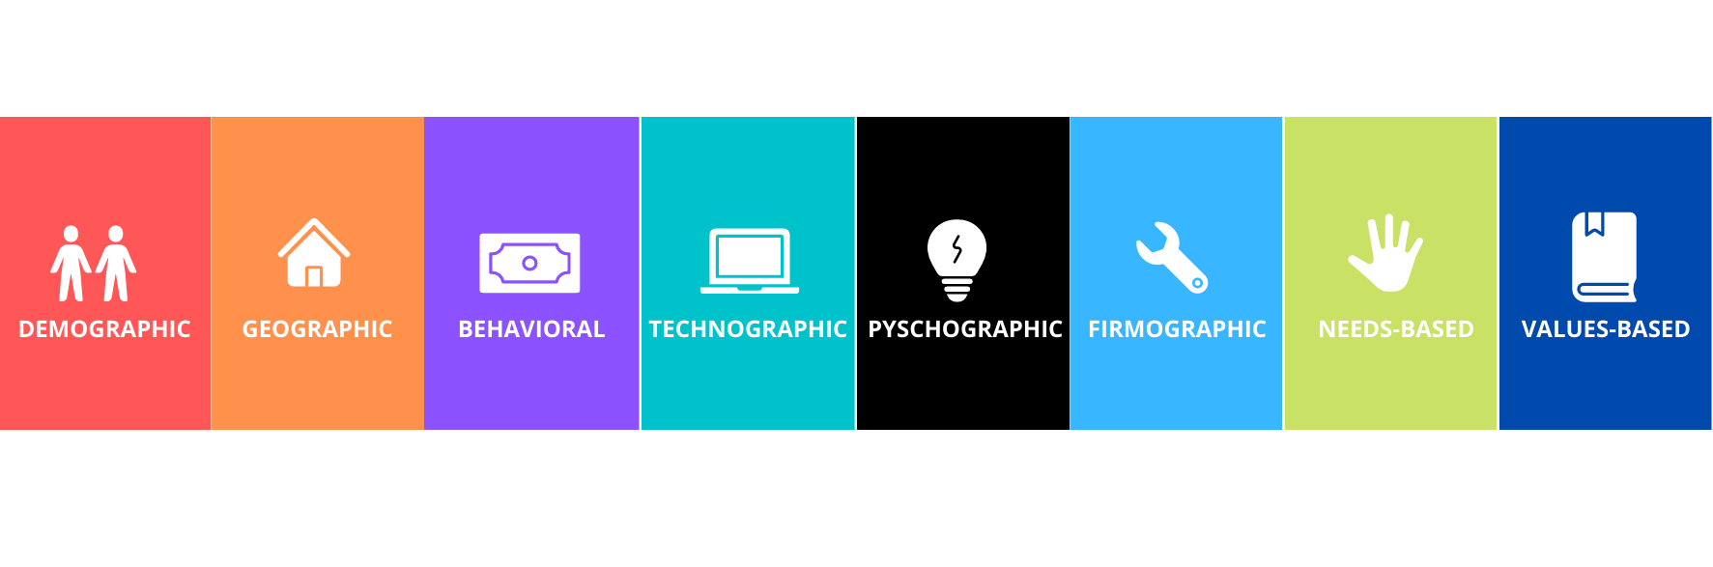
What are the Types of Customer Segmentation Models?

Slide 12
1.Demographic Segmentation
Demographics are population-related characteristics such as income, education level, gender, and age. The various demographic characteristics can be used together to create segmented customer groups, most useful to brands that sell a variety of products.

Slide 13
2.Behavioral Segmentation
Behavioral segmentation groups consumers together by habits and behaviors, rather than external demographic factors. For example, purchase history and preferred social media platform usage. You can focus ads on a certain social platform to reach and/or create reminder or sales emails to regular or repeat online buyers.

Slide 14
3.Psychographic Segmentation
Psychographic segmentation dives even deeper into the internal workings of your consumers by grouping them together based on psychological characteristics, including personality, habits, beliefs, and interests.
Psychographics are great for lifestyle brands that want to align themselves with consumers who live or aspire to live the lifestyle that the brand promotes. Brands that sell outdoor camping gear, for example, want to connect with outdoor and travel enthusiasts.

Slide 15
4.Geographic Segmentation
Geographic location is important to brands in a number of industries. Real estate agencies, for example, want to connect with homeowners selling their homes, potential buyers, and people looking to relocate to a specific area.

Slide 16
5.Technographic Segmentation
Technographic segmentation, or creating subgroups and customer profiles around the technology your consumers use, is becoming increasingly popular. As more businesses have moved their operations online, this has opened the door to growth in industries like SaaS and online marketing analytics.
Technographic segmentation lets you target consumers that use different types of software or online services in a highly personalized fashion.

Slide 17
6.Firmographic Segmentation
Millennials vs. Gen X’ers vs. Gen Z vs. Boomers – we’re becoming more and more comfortable with the idea of these generational divides. So much so that firmographic segmentation, or creating subgroups simply around the decades or eras into which your consumers were born, is also on the rise.
And it makes sense – someone born in 1980 will be at a different stage of life, with different needs and concerns, than someone born in 2000.

Slide 18
7.Needs-Based Segmentation
Needs-based segmentation begins with a simple question: Who needs what you’ve got?
Dividing your consumers into groups around their needs is a great way to keep your marketing messages focused tightly on your products or services and how they meet those needs. A clothing company can market office casual wear to business professionals, athletic gear to yoga enthusiasts, and kids' clothing to families.

Slide 19
8.Value-Based Segmentation
This model takes the lens and focuses it more directly on what serves your brand. Which group or groups of customers are currently providing the most value – the most return business, the highest return on your ROI?
Using lifetime value as your measuring stick, you can target your marketing messages to the consumers that are your biggest supporters and focus on continuing to build that loyalty and trust.

Slide 20
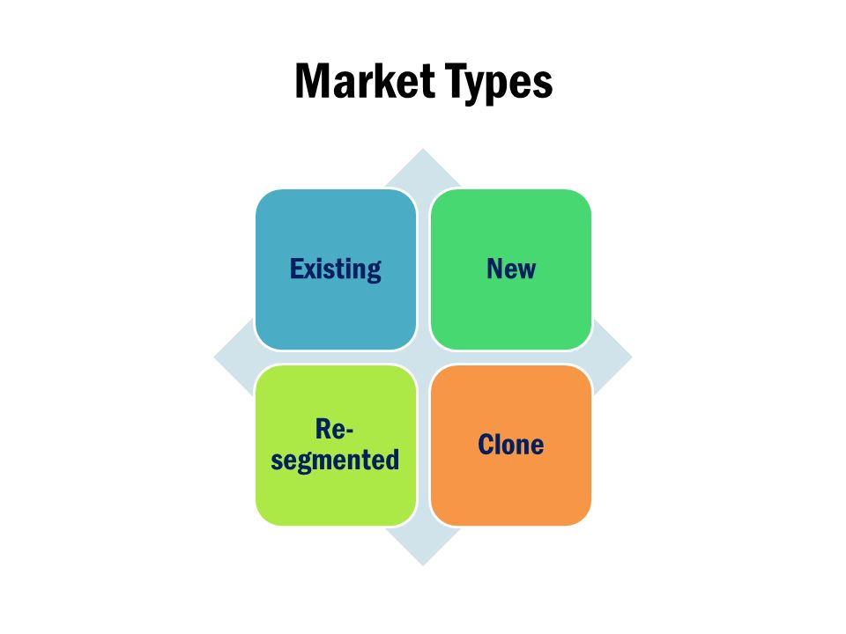
MARKET

Slide 21
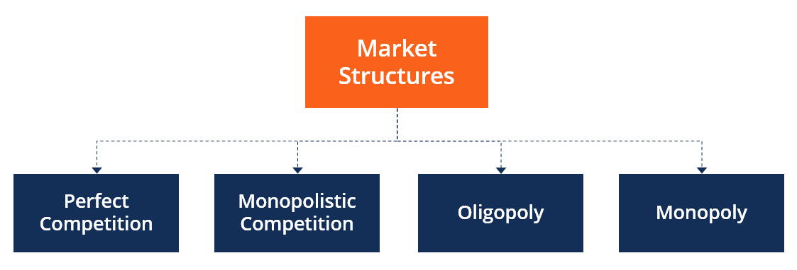

Slide 22
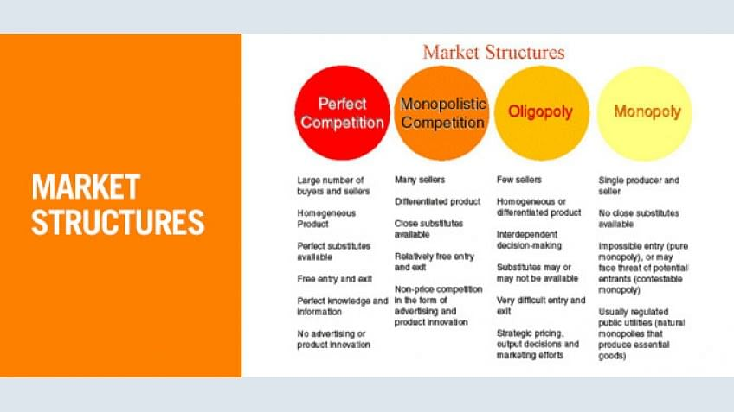
Customer Segmentation Models

Slide 23
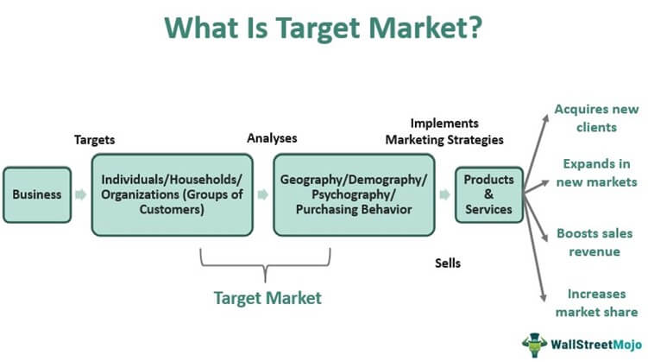

Slide 24
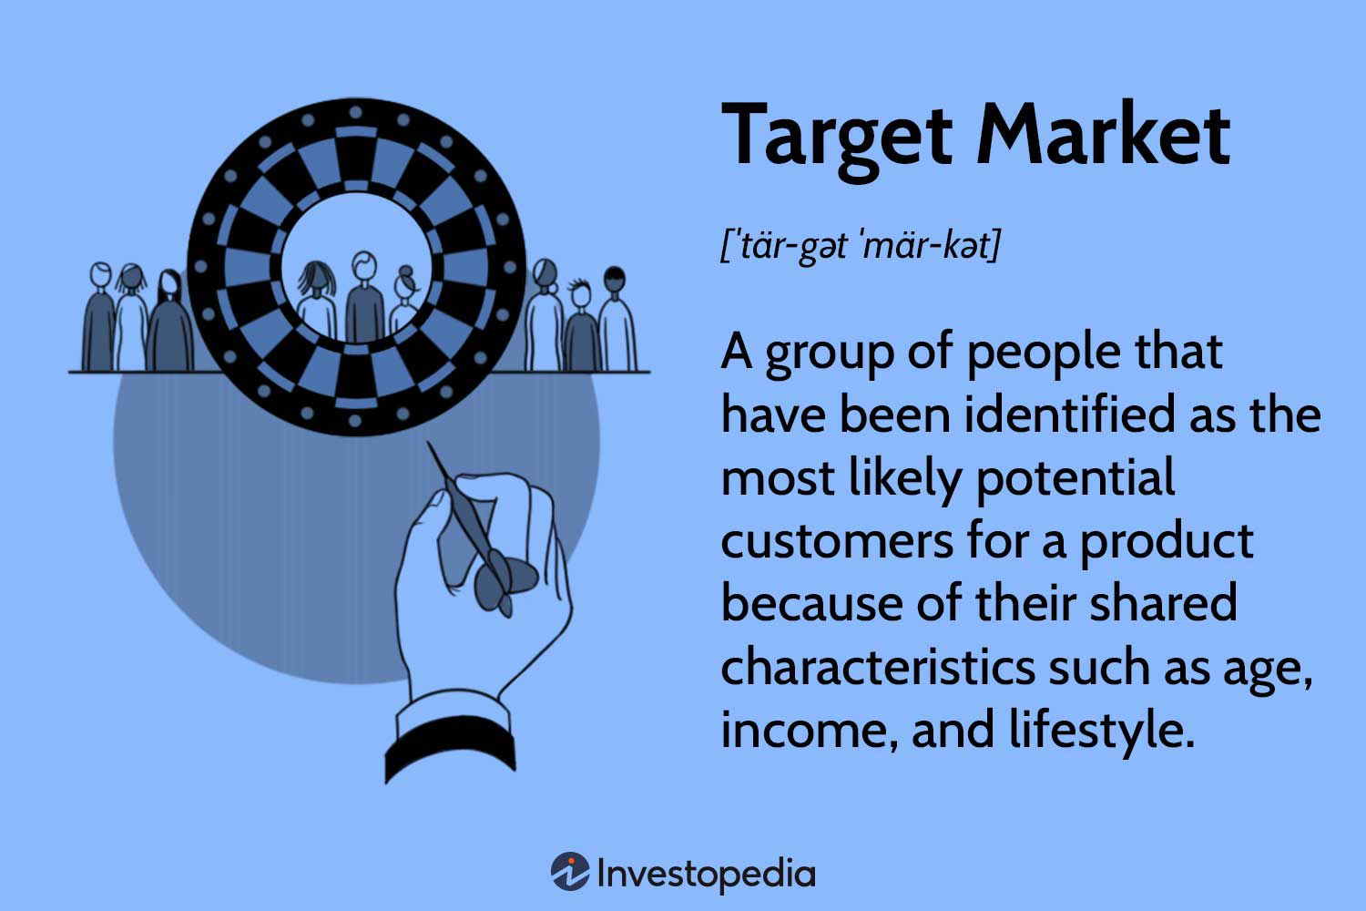

Slide 25
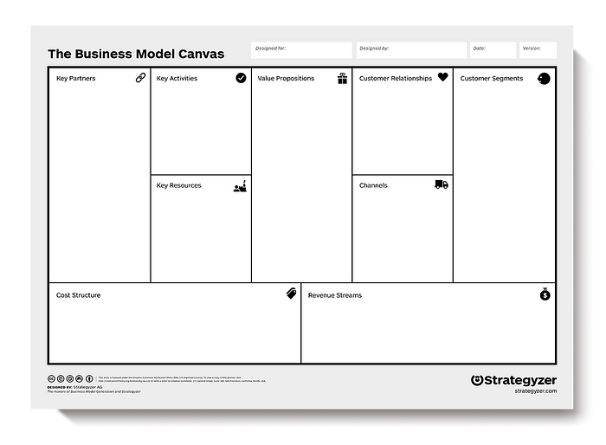

Slide 26
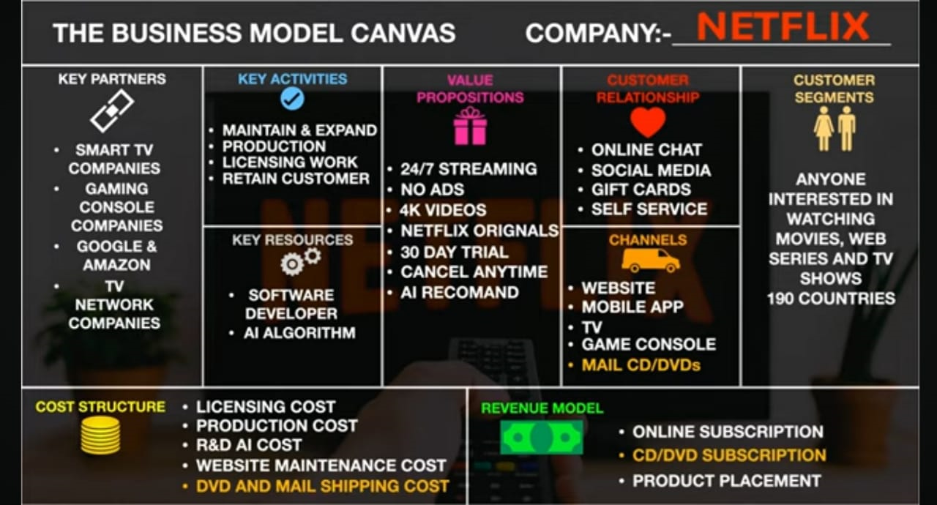

Slide 27
Value Proposition Canvas
​1. Introduction
• What is Value Proposition?
• What is a Value Proposition Canvas?
• Benefits of Using a Value Proposition Canvas
2. Basics of Design Thinking
• Principles of Design Thinking
3. Value Proposition Design Process
• Value Proposition Design Process
• An Integrated Suite of Tools
• Online Strategyzer Tools
4. Value Proposition Canvas
• Framework of the Value Proposition Canvas
• Examples – Tesla, Toyota, Adidas & Home Dialysis Machine
5. Customer Profile
• Customer Segment Profile
• Customer Jobs
• Customer Pains
• Customer Gains
• Steps to Create an Actionable Customer Profile
6. Value Map
• Value (Proposition) Map
• Products & Services
• Pain Relievers
• Gain Creators
• Steps to Create a Value Map
7. Fit: Aligning Customer Needs and Value
• Fit Overview
• Test Your Assumptions with the Customer
• Find the Best Fit
8. Best Practices
• Common Mapping Mistakes – Customer Profile
• Common Mapping Mistakes – Value Map
• Critical Success Factors

